Slide 2
Lecture 27 and 28 DISCRETE STRUCTURE
SARA SHAFIQUE

Slide 3


Probability Use in Computer Science
Speech Recognition

Slide 4
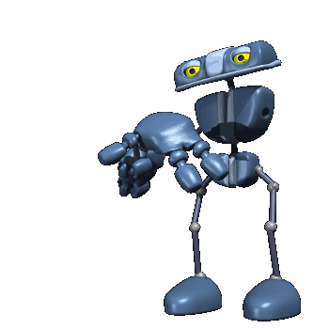
Probability Use in Computer Science
Robotics

Slide 5

Probability Use in Computer Science
Network Traffic

Slide 6
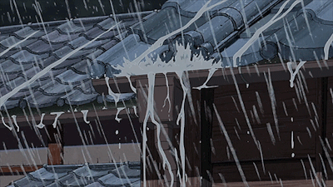

Probability
Probability: represent the possibility
Definition: Probability is the likelihood (chance) of an event occurring
Basic formula :
Probability = | the number of ways of achieving success
 | the total number of possible outcomes

Slide 7
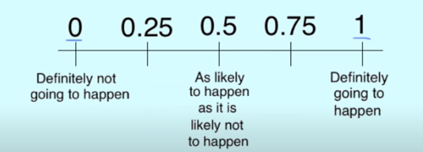

Points to Remember about Probability
The probability of an event can only be between 0 and 1 and can also be written as a percentage.
The probability of event A is often written as P(A).
If P(A) > P(B), then event A has a higher chance of occurring than event B.
If P(A) = P(B), then events A and B are equally likely to occur.

Slide 8

Basic Terminologies of Probability
Random Experiment
A random experiment is a repeatable action that results in one of a well-defined set of outcomes.

Slide 9
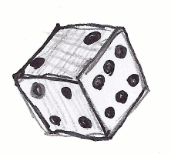
Basic Terminologies of Probability : Random Experiment – Example 1
Tossing a dice is an example of a random experiment.

Slide 10

Basic Terminologies of Probability : Random Experiment – Example 2
Another example of a random experiment is flipping a coin.

Slide 11
Basic Terminologies of Probability : Sample Size or Sample Space
We denote Sample size by capital S.
The sample space S of a random experiment is the set of all possible outcomes of the experiment.
Example
for the dice-tossing experiment S = {I, 2, 3,4,5, 6}.
For the coin-flipping experiment S = {H, T}.

Slide 12
Basic Terminologies of Probability : Event
A subset of a sample space is called an event.
Simple events are the I-element subsets of the sample space.
We denote events by capital letters.
For the dice-tossing experiment, the simple events are {I}, {2}, {3}, {4}, {5}, {6}.
Some other events in this sample space are:
An even number is rolled, E = {2,4,6}
An odd number is rolled, 0 = {I, 3, 5}

Slide 13
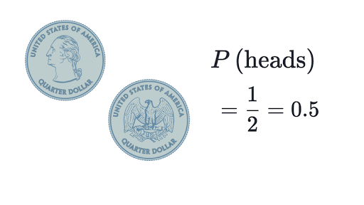
1st Example of Probability : 1 Coin Tossing
Probability of an event = (# of ways it can happen) / (total number of outcomes)

Slide 14
2nd Example of Probability : Rolling 1 Dice
There are six different outcomes.

Slide 15
2nd Example of Probability : Rolling 1 Dice
What’s the probability of rolling a one?

Slide 16
2nd Example of Probability : Rolling 1 Dice
What’s the probability of rolling a one?
Probability of an event = (# of ways it can happen) / (total number of outcomes)
P(1) = 1 / 6

Slide 17
2nd Example of Probability : Rolling 1 Dice
What’s the probability of rolling a one or a six?

Slide 18
2nd Example of Probability : Rolling 1 Dice
What’s the probability of rolling a one?
Probability of an event = (# of ways it can happen) / (total number of outcomes)
P(1 or 6) = 2 / 6
P(1 or 6) = 1 / 3

Slide 19
2nd Example of Probability : Rolling 1 Dice
What’s the probability of rolling an even number (i.e., rolling a two, four or a six)?

Slide 20
2nd Example of Probability : Rolling 1 Dice
What’s the probability of rolling a one?
Probability of an event = (# of ways it can happen) / (total number of outcomes)
P(even) = 3 / 6
P(even) = 1/ 2

Slide 21

3rd Example of Probability
There are 6 beads in a bag, 3 are red, 2 are yellow and 1 is blue. What is the probability of picking a yellow?

Slide 22

3rd Example of Probability
There are 6 beads in a bag, 3 are red, 2 are yellow and 1 is blue. What is the probability of picking a yellow?
Probability of an event = (# of ways it can happen) / (total number of outcomes)
P(yellow) = 2 / 6
P(yellow) = 1 / 3

Slide 23
Combination
In English we use the word "combination", without thinking if the order of things is important.

Slide 24
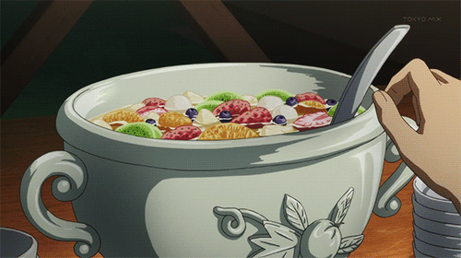
Combination Daily Life Example
“If fruit salad is a combination of apples, grapes and bananas" We don't care what order the fruits are in, they could also be "bananas, grapes and apples" or "grapes, apples and bananas", its the same fruit salad.

Slide 25
Permutation
By English language definition, each of several possible ways in which a set or number of things can be ordered or arranged.

Slide 26

Permutation Daily Life Example
"The combination to the safe is 472". Now we do care about the order. "724" won't work, nor will "247". It has to be exactly 4-7-2.

Slide 27
Mathematical definition of Permutation and Combination
When the order doesn't matter, it is a Combination.
When the order does matter it is a Permutation.

Slide 28
Permutations Types
There are basically two types of permutation:
Repetition is Allowed: such as the locker Example. It could be "333".

Slide 29
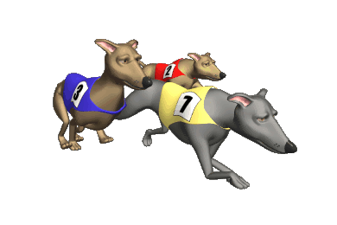
Permutations Types
There are basically two types of permutation:
2) No Repetition: for example, the first three people in a running race. You can't be first and second.

Slide 30
Permutations with Repetition Formula
n^{r}
where n is the number of things to choose from, and we choose r of them, repetition is allowed, and order matters.

Slide 31
Exponent
The exponent of a number says how many times to use the number in a multiplication.
Example
In 8^2 the "2" says to use 8 twice in a multiplication,
So, 8^2 = 8 × 8 = 64

Slide 32
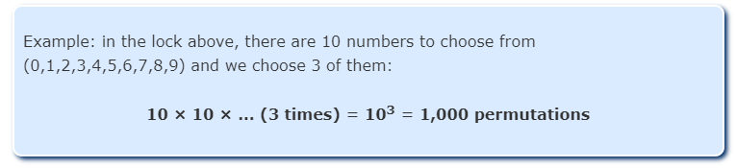
Permutations with Repetition Example

Slide 33

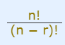
Permutations without Repetition Formula
where n is the number of things to choose from, and we choose r of them, no repetitions, order matters.

Slide 34

Permutations without Repetition
The factorial function (symbol: !) just means to multiply a series of descending natural numbers. Examples: 4! = 4 × 3 × 2 × 1 = 24 7! = 7 × 6 × 5 × 4 × 3 × 2 × 1 = 5,040 1! = 1
Note: it is generally agreed that 0! = 1.
But how do we write Permutations without Repetition mathematically?
we use the "factorial function“

Slide 35
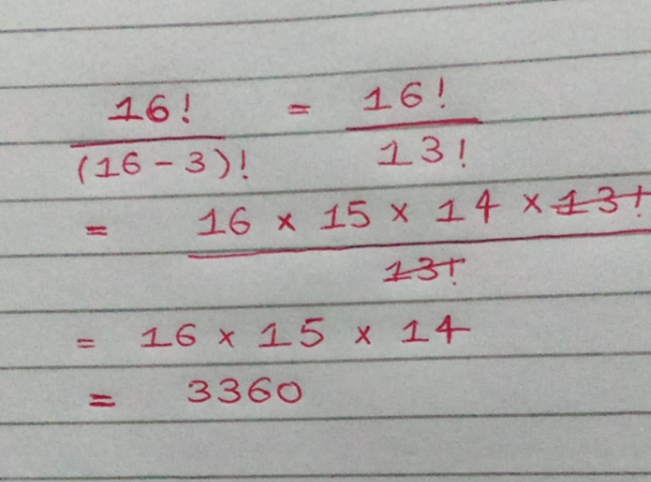
Suppose we have 16 pool balls and we selected 3 balls.

Slide 36

Permutations without Repetition Example
How many ways can first and second place be awarded to 10 people?

Slide 37
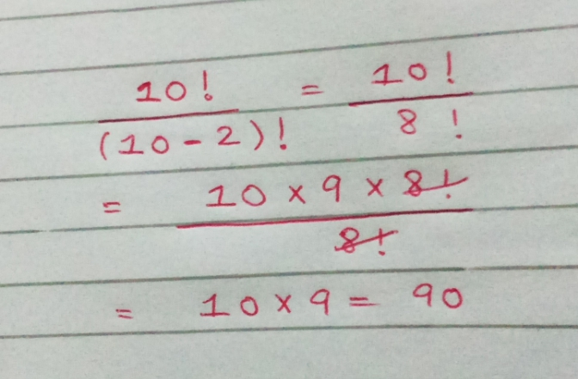
Permutations without Repetition Example
How many ways can first and second place be awarded to 10 people?

Slide 38
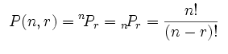
Notations that are commonly use for Permutation

Slide 39
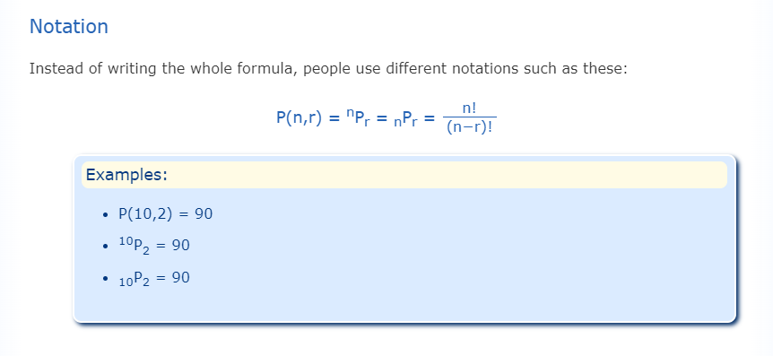

Slide 40

Permutation Without Repetition Example
A license plate begins with three letters. If the possible letters are A, B, C, D, and E, how many different permutations of these letters can be made if no letter is used more than once?

Slide 41
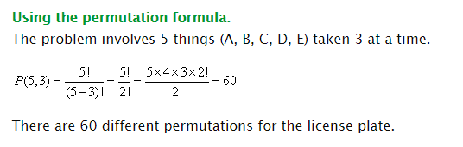
Permutation Without Repetition Example
A license plate begins with three letters. If the possible letters are A, B, C, D, and E, how many different permutations of these letters can be made if no letter is used more than once?

Slide 42
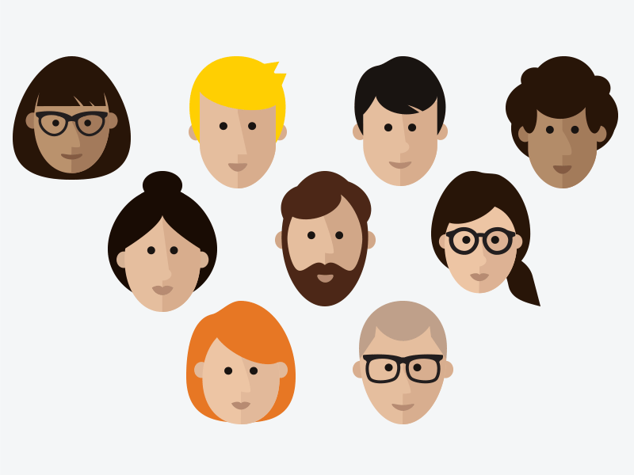
Permutation Without Repetition Example
In how many ways can a president, a treasurer and a secretary be chosen from among 7 candidates?

Slide 43
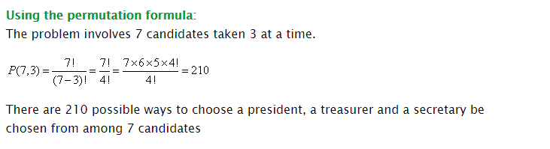
Permutation Without Repetition Example
In how many ways can a president, a treasurer and a secretary be chosen from among 7 candidates?

Slide 44
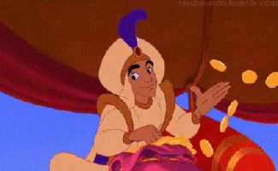

Combinations
There are also two types of combinations (remember the order does not matter now):
Repetition is Allowed: such as coins in your pocket (5,5,5,10,10)
2) No Repetition: such as lottery numbers (2,14,15,27,30,33)

Slide 45
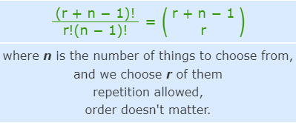
Combinations with Repetition Formula

Slide 46

1) Combinations with Repetition
Let us say there are five flavors of ice cream: banana, chocolate, lemon, strawberry and vanilla. We can have three scoops. How many variations will there be? Let's use letters for the flavors: {b, c, l, s, v}. Example selections include {c, c, c} (3 scoops of chocolate), {b, l, v} (one each of banana, lemon and vanilla),{b, v, v} (one of banana, two of vanilla)

Slide 47
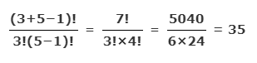
1) Combinations with Repetition
Let us say there are five flavors of ice cream: banana, chocolate, lemon, strawberry and vanilla. We can have three scoops. How many variations will there be? Let's use letters for the flavors: {b, c, l, s, v}. Example selections include {c, c, c} (3 scoops of chocolate), {b, l, v} (one each of banana, lemon and vanilla),{b, v, v} (one of banana, two of vanilla)

Slide 48
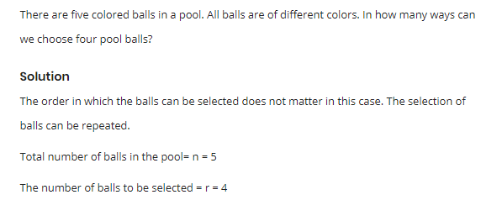
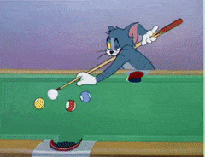
1) Combinations with Repetition

Slide 49
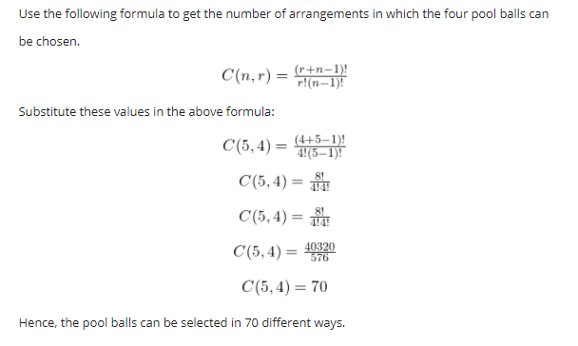
1) Combinations with Repetition

Slide 50
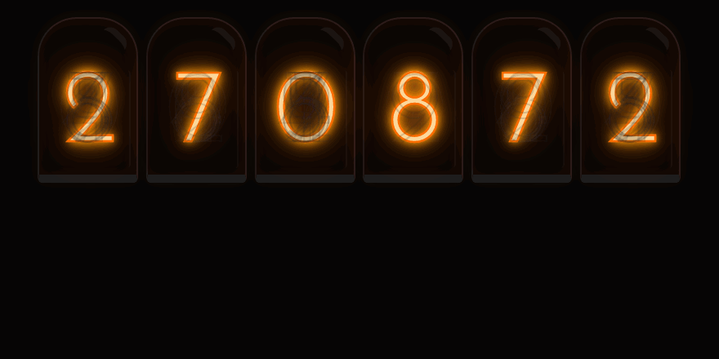
2. Combinations without Repetition
This is how lotteries work. The numbers are drawn one at a time, and if we have the lucky numbers (no matter what order) we win!

Slide 51
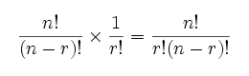
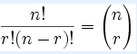
2. Combinations without Repetition Formula
we adjust our permutations formula to reduce it by how many ways the objects could be in order (because we aren't interested in their order anymore):
where n is the number of things to choose from, and we choose r of them, no repetition, order doesn't matter.

Slide 52
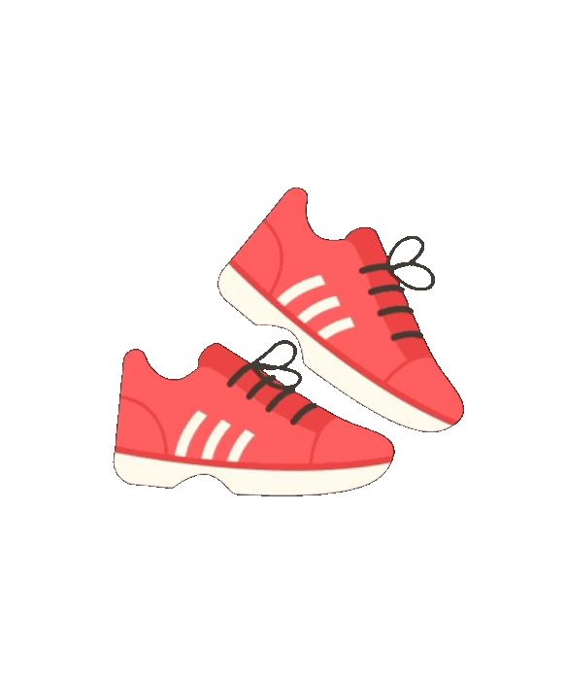



2. Combinations without Repetition Example
2 girls will go to a party, if between the two, they have 4 pairs of fancy shoes, define the combination of shoes this two girls can wear

Slide 53
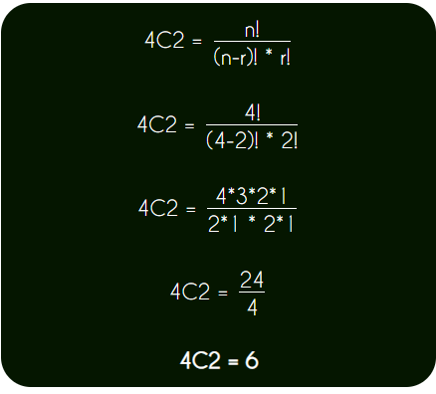
2. Combinations without Repetition Example
2 girls will go to a party, if between the two, they have 4 pairs of fancy shoes, define the combination of shoes this two girls can wear

Slide 54

2. Combinations without Repetition Example
A man will go on a trip for 3 days, so he will take with him 3 shirts, if he has 7 shirts, how many combination of shirts can he take.

Slide 55
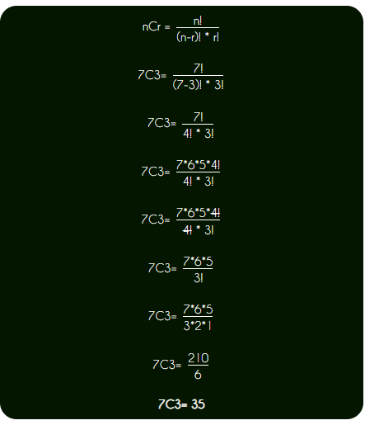
2. Combinations without Repetition Example
A man will go on a trip for 3 days, so he will take with him 3 shirts, if he has 7 shirts, how many combination of shirts can he take.

Slide 56
Difference between Combination and Permutation
Here are a few examples of combinations (order doesn’t matter) from permutations (order matters).
Combination:
Picking a team of 3 people from a group of 10.
C(10,3) = 10!/(7! · 3!) = 10 · 9 · 8 / (3 · 2 · 1) = 120.
Permutation:
Picking a President, VP, and Water boy from a group of 10.
P(10,3) = 10!/7! = 10 · 9 · 8 = 720.
Combination:
Choosing 3 desserts from a menu of 10.
C(10,3) = 120.
Permutation:
List your 3 favorite desserts, in order, from a menu of 10.
P(10,3) = 720.

Slide 57
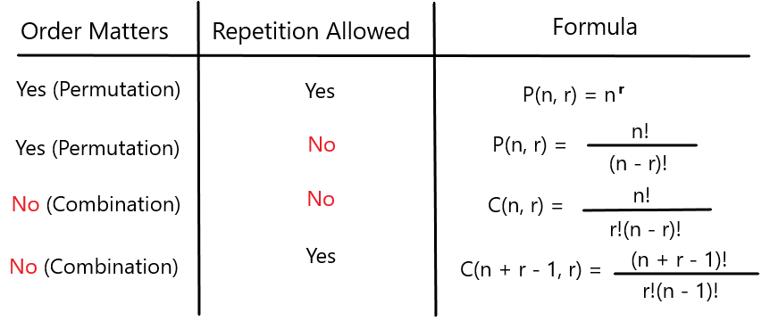

Slide 58
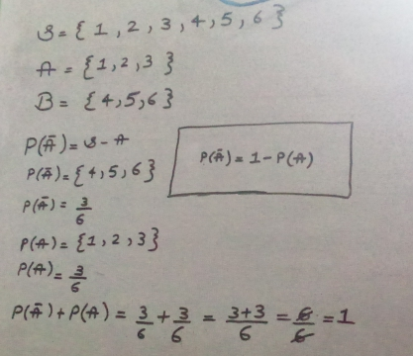
Complement of Probabilities

Slide 59
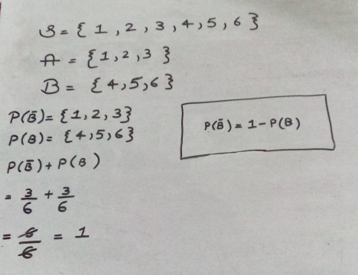
Complement of Probabilities

Slide 60
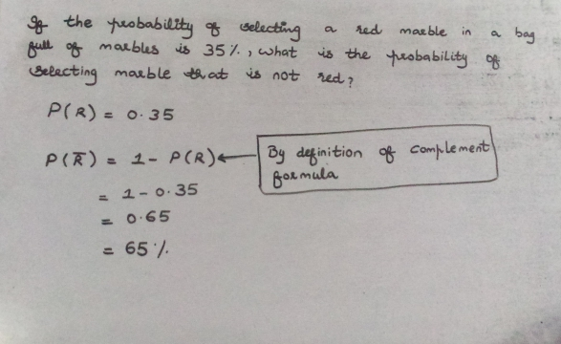
Complement of Probabilities

Slide 61
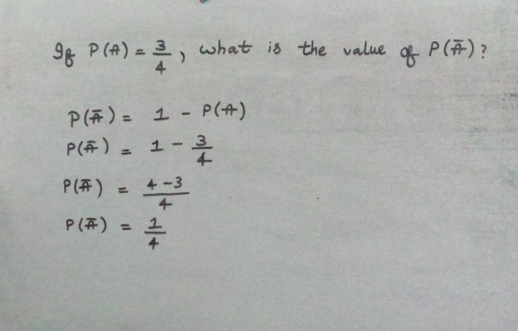
Complement of Probabilities

Slide 62
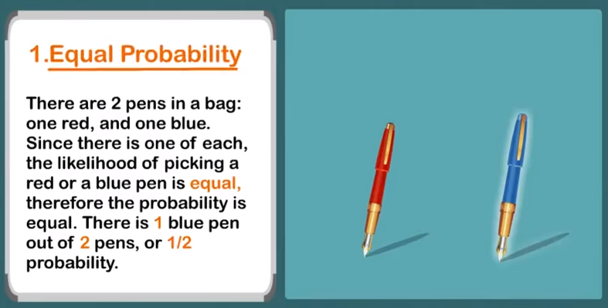

Slide 63
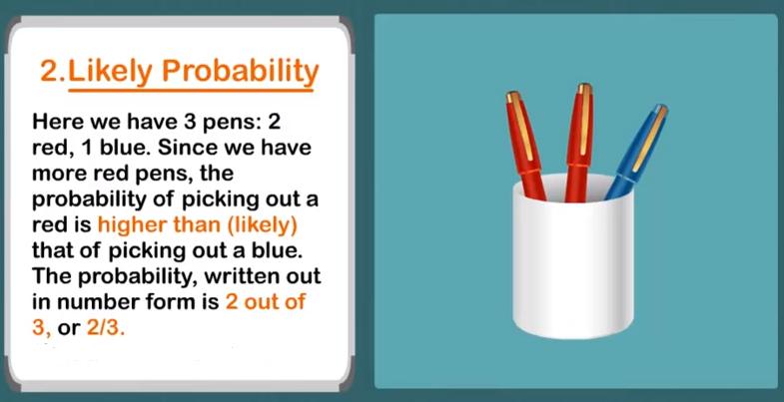

Slide 64
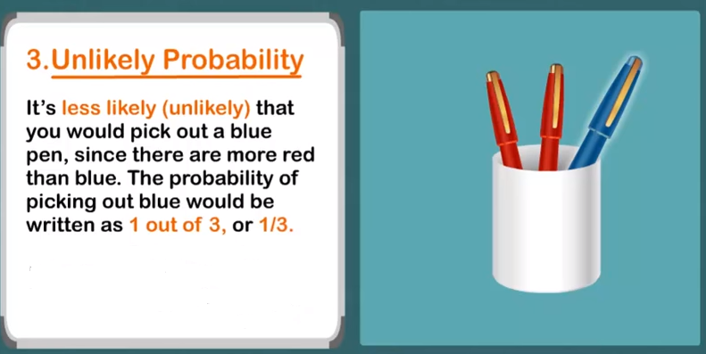

Slide 65
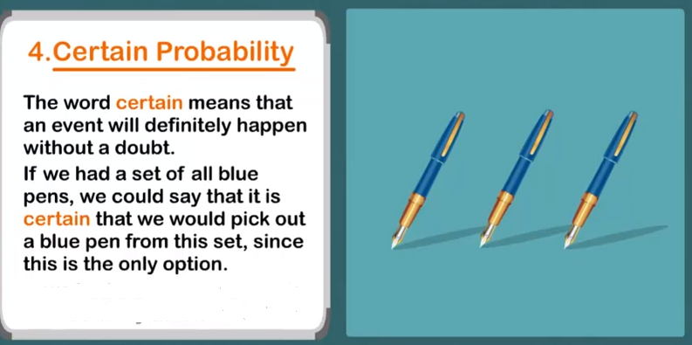

Slide 66
